Slide 1


Loan Default Risk Classification
A Comprehensive Machine Learning Framework for Predicting Loan Defaults using Advanced Tree-Based Architectures and SHAP Explainability.

Slide 2
Project Foundation
Strategic objectives and dataset profiling for high-precision credit risk assessment.

Slide 3



Executive Overview
The Challenge
The Solution
Financial institutions face systemic losses due to inaccurate default predictions. Traditional scoring models often overlook subtle, non-linear interactions between borrower attributes and economic shifts.
Developing a robust predictive pipeline prioritizing Recall to catch defaults early. Maximizing the detection rate allows credit divisions to isolate high-risk profiles before exposure happens.

Slide 4

Dataset & Exploratory Insights
Key Feature Behavior
Data Profile
EXT_SOURCE_2: Emerged as the primary discriminator; lower scores correlate exponentially with default risk.
307K+ Total Applicants 100+ Initial Feature Space 8% Defaulter Minority Class 8 Highly Predictive Features Retained
Income Distributions: Applied Log transformation to normalize right-skewed income data, stabilizing gradient descent.
Leverage Ratios: Engineered Loan-to-Income features to capture borrower debt capacity beyond absolute credit limits.

Slide 5
Data Preprocessing Pipeline
Pruning
Imputation
Feature Selection
Standardization
Removed features with >50% missing values to ensure data quality.
Numeric: Median fill Categorical: Mode fill
StandardScaler applied to normalize input variance.
8 features retained via correlation and domain logic.

Slide 6
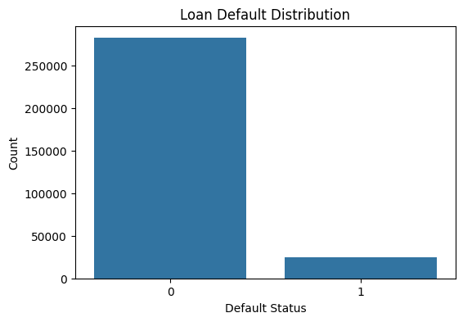
Target Variable Distribution: Addressing Class Imbalance
Visualizing the target variable reveals a heavy 92% (Non-Default) to 8% (Default) split.
The Risk: This extreme skew introduces severe algorithmic bias, where models naturally favor the majority class to inflate overall accuracy.
The Strategy: Highlighting this imbalance justifies why we shifted our evaluation metrics away from raw accuracy to focus strictly on Recall and ROC-AUC.

Slide 7
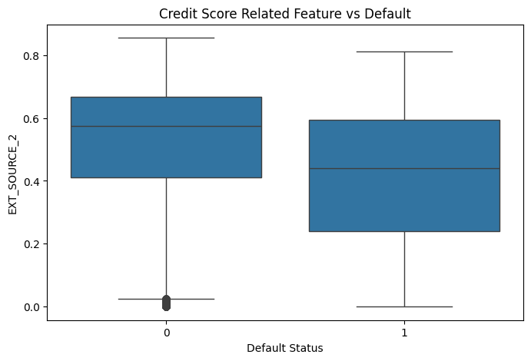
Risk Distribution: EXT_SOURCE_2 vs. Default Status
Strong Predictor: Clear separation between groups shows this feature is highly effective at identifying risk.
Higher Scores, Less Risk: Non-defaulters (0) have a significantly higher median score (~0.58).
Lower Scores, Higher Risk: Defaulters (1) are heavily concentrated at lower score ranges, averaging a median of ~0.44.

Slide 8
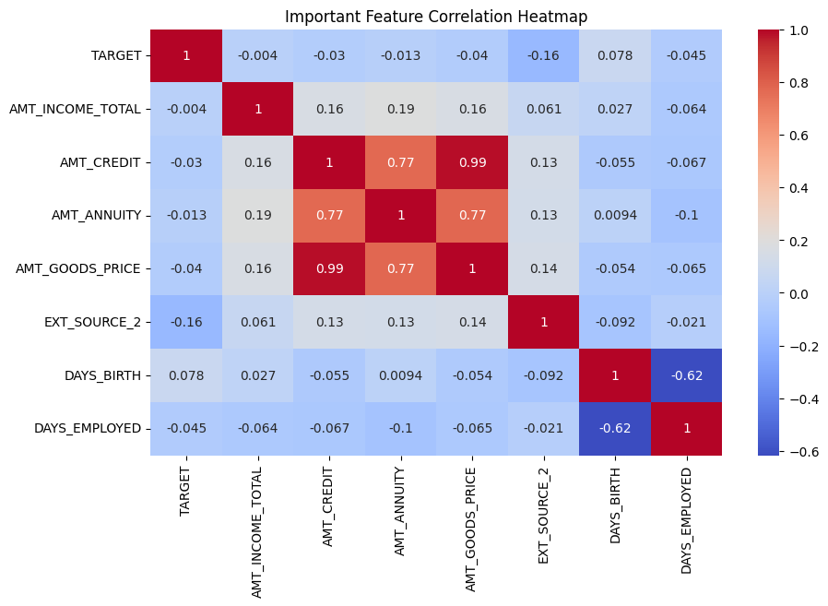
Key Correlations with Target Variable
Key Insights:
Strongest Risk Predictor: EXT_SOURCE_2 has the highest correlation with default risk (-0.16); higher scores mean lower risk.
Age Factor: DAYS_BIRTH indicates younger applicants carry a slightly higher risk of default (0.078).
Feature Redundancy: Loan amount features (AMT_CREDIT, AMT_GOODS_PRICE, AMT_ANNUITY) are highly collinear (up to 0.99).
Action Item: Consider dropping or combining the redundant loan amount features to prevent model overfitting.

Slide 9
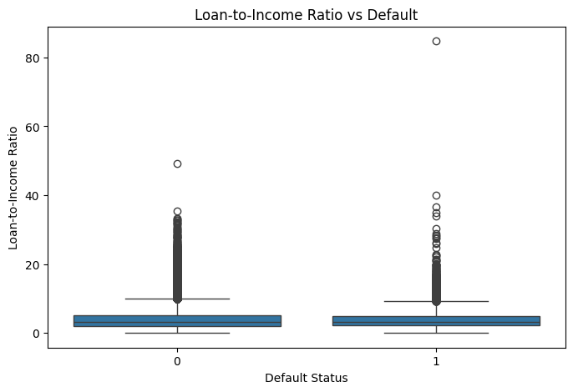
Confusion Matrix Comparison of Machine Learning Models
Loan-to-Income Ratio Analysis by Default Status
The boxplot compares the loan-to-income ratio between default and non-default customers.
Customers with default status (1) generally show slightly higher loan-to-income ratios compared to non-default customers.
Several outliers are present in both groups, indicating some customers have extremely high loan burdens relative to income.
A higher loan-to-income ratio may increase the likelihood of loan default.

Slide 10






Managing Class Imbalance
The Imbalance Problem
Strategic Importance
Optimization Goal
A heavy 92% vs 8% split leads models like default LightGBM to converge toward predicting zero defaults, showing high accuracy but zero tracking capability.
Because missing a default is drastically more expensive than a false alarm, standard overall Accuracy must be bypassed in favor of maximizing Recall.
Selecting models that maintain balanced discriminant boundaries to capture high-risk default patterns effectively.

Slide 11
Core Feature Configuration
Feature Name | Engineering Logic / Source | Risk Influence
EXT_SOURCE_2 | Normalized External Credit Proxy | High (Inverse)
LOAN_TO_INCOME_RATIO | AMT_CREDIT / AMT_INCOME_TOTAL | High (Direct)
DAYS_BIRTH | Age derived from application timestamp | Medium
AMT_CREDIT | Total principal amount requested | Medium
DAYS_EMPLOYED | Continuous employment duration | Medium

Slide 12
Model Comparison Benchmarks
Model Architecture | Accuracy | Precision | Recall | F1-Score | ROC-AUC
Logistic Regression (Best) | 0.6624 | 0.1356 | 0.5921 | 0.2207 | 0.6792
Random Forest | 0.6641 | 0.1351 | 0.5851 | 0.2195 | 0.6784
LightGBM (Imbalanced baseline) | 0.9193 | 0.0000 | 0.0000 | 0.0000 | 0.6284
Analysis: While LightGBM scores a high accuracy (91.93%), it fails entirely to find any defaults (0% Recall). Logistic Regression is selected as the optimal model, delivering the highest Recall (0.5921) and best ROC-AUC (0.6792).

Slide 13
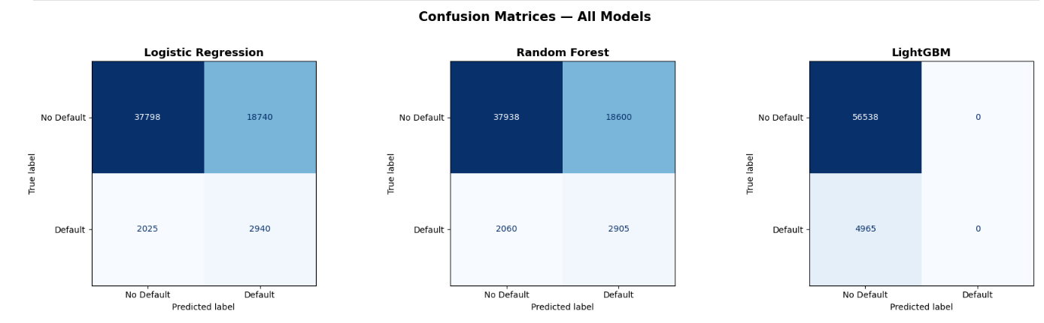
Confusion Matrix Comparison of Machine Learning Models
Confusion Matrix Comparison of Machine Learning Models

Slide 14
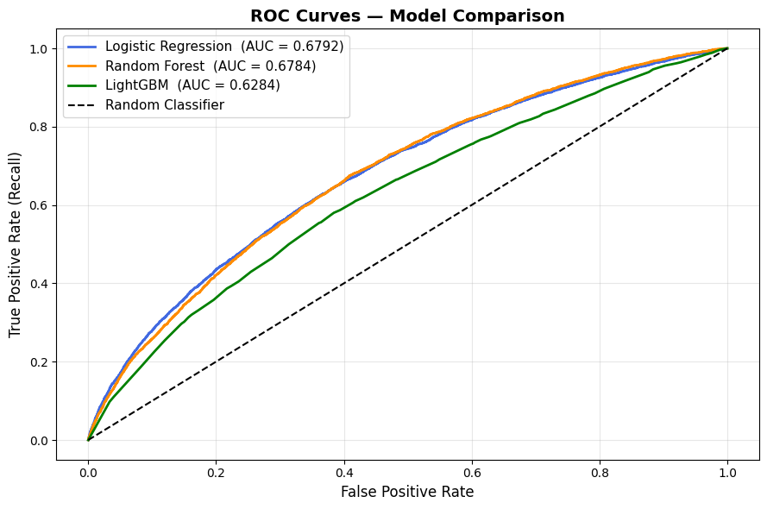
Confusion Matrix Comparison of Machine Learning Models
ROC Curve and AUC Score Comparison of Models
The ROC curve compares the classification performance of Logistic Regression, Random Forest, and LightGBM models.
Logistic Regression and Random Forest show better performance with higher AUC scores (~0.68), indicating better ability to distinguish between default and non-default cases.
LightGBM has a lower AUC score (~0.63), showing weaker classification performance.
The closer the ROC curve is to the top-left corner, the better the model performance.

Slide 15
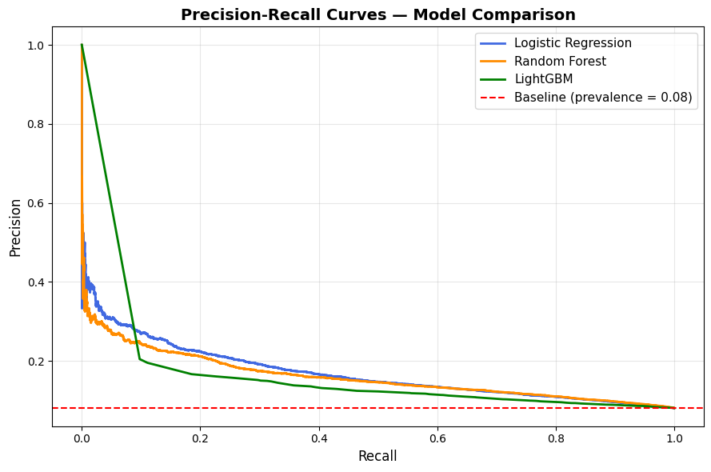
Confusion Matrix Comparison of Machine Learning Models
Precision–Recall Curve Comparison of Models
The Precision–Recall curves evaluate how well the models identify default cases in an imbalanced dataset.
Logistic Regression and Random Forest maintain better precision and recall performance compared to LightGBM.
LightGBM shows lower precision as recall increases, indicating weaker detection of default cases.
Curves above the baseline indicate better model performance, with Logistic Regression showing the most balanced results overall.

Slide 16

Explainability with SHAP
TreeExplainer Logic
Top SHAP Predictors
We utilized shap.TreeExplainer to quantify how each feature shifts the base prediction. This provides local interpretability for individual loan approvals.
EXT_SOURCE_2: Most significant impact.
LOAN_TO_INCOME_RATIO: Direct risk multiplier.
AMT_CREDIT: Key indicator of capacity.
AMT_INCOME_TOTAL: Stability verification.

Slide 17



Streamlit Real-Time Assessment
The Interface
Visual Outputs
An interactive dashboard designed for credit analysts. Features 2-column input forms for rapid applicant data entry and multi-model parallel processing.
Probability results displayed via Plotly Gauge charts. Risk categorization follows a traffic-light protocol: Green (Low), Yellow (Med), Red (High).

Slide 18
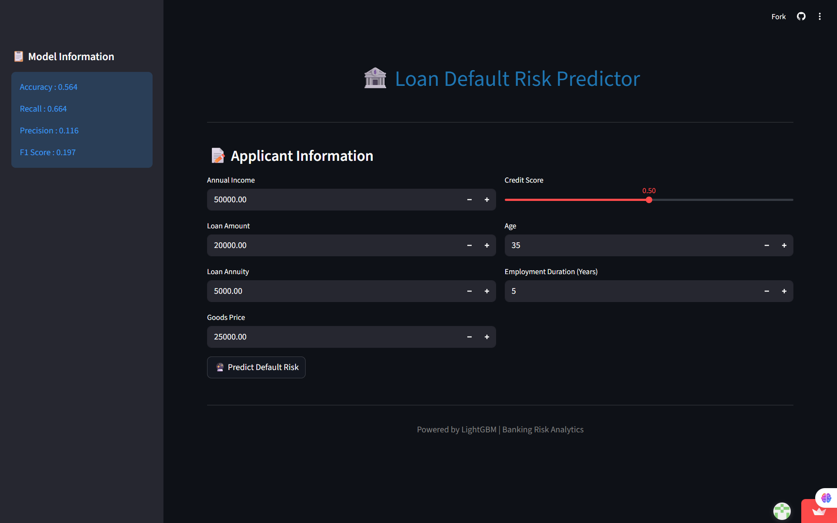
DEPLOYMENT ENVIRONMENT(Home page)

Slide 19
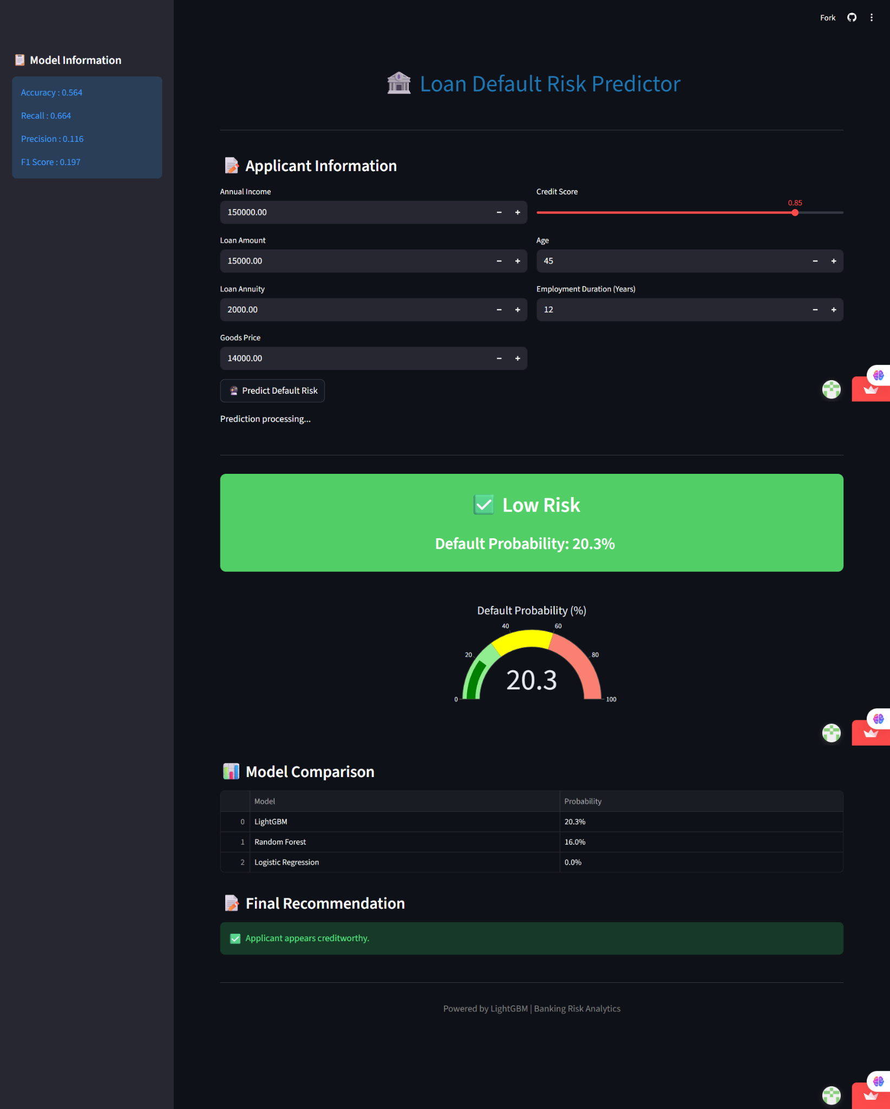
DEPLOYMENT ENVIRONMENT(low risk)
.

Slide 20
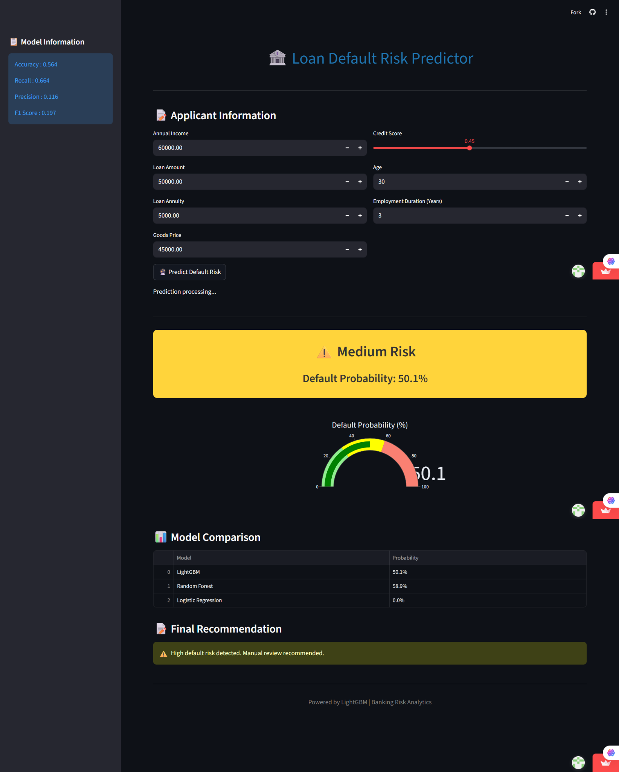
DEPLOYMENT ENVIRONMENT(Medium risk)
.

Slide 21
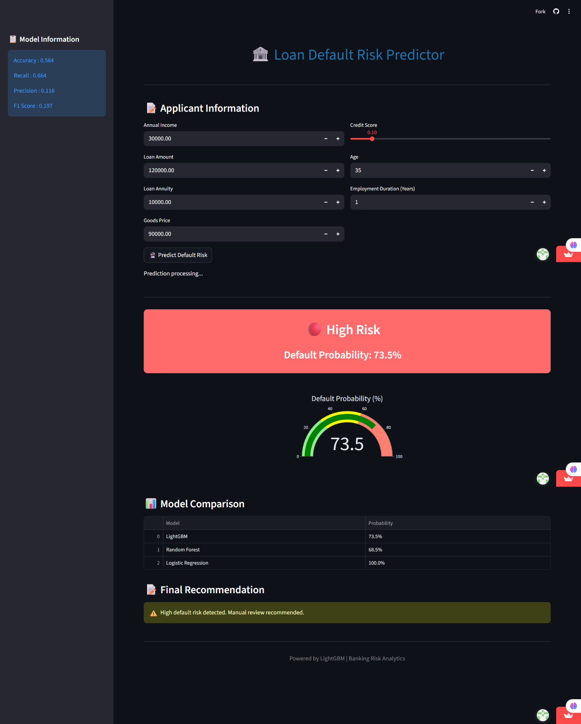
DEPLOYMENT ENVIRONMENT(High Risk)
.

Slide 22

Key Strategic Takeaways
The Accuracy Paradox: A model predicting that no one defaults achieves 91.93% accuracy but holds zero business utility.
Model Selection: Logistic Regression successfully breaks majority class bias to surface **59.21%** of actual risk occurrences.
Interpretability: SHAP integration matches feature selections directly against individual customer application scores for regulatory transparent reporting.
Feature Engineering: Ratios like `LOAN_TO_INCOME_RATIO` provided significantly stronger predictive weights during separation tasks.

Slide 23
THANK YOU
Team Members:-Sreekutty Santhosh,Laniya Mohan,Theertha Vijayachandran

